Slide 1




An overview of methods for efficient
generative AI training & inference
Constantine Dovrolis
The Cyprus Institute (CyI)
and
Georgia Tech

Slide 2
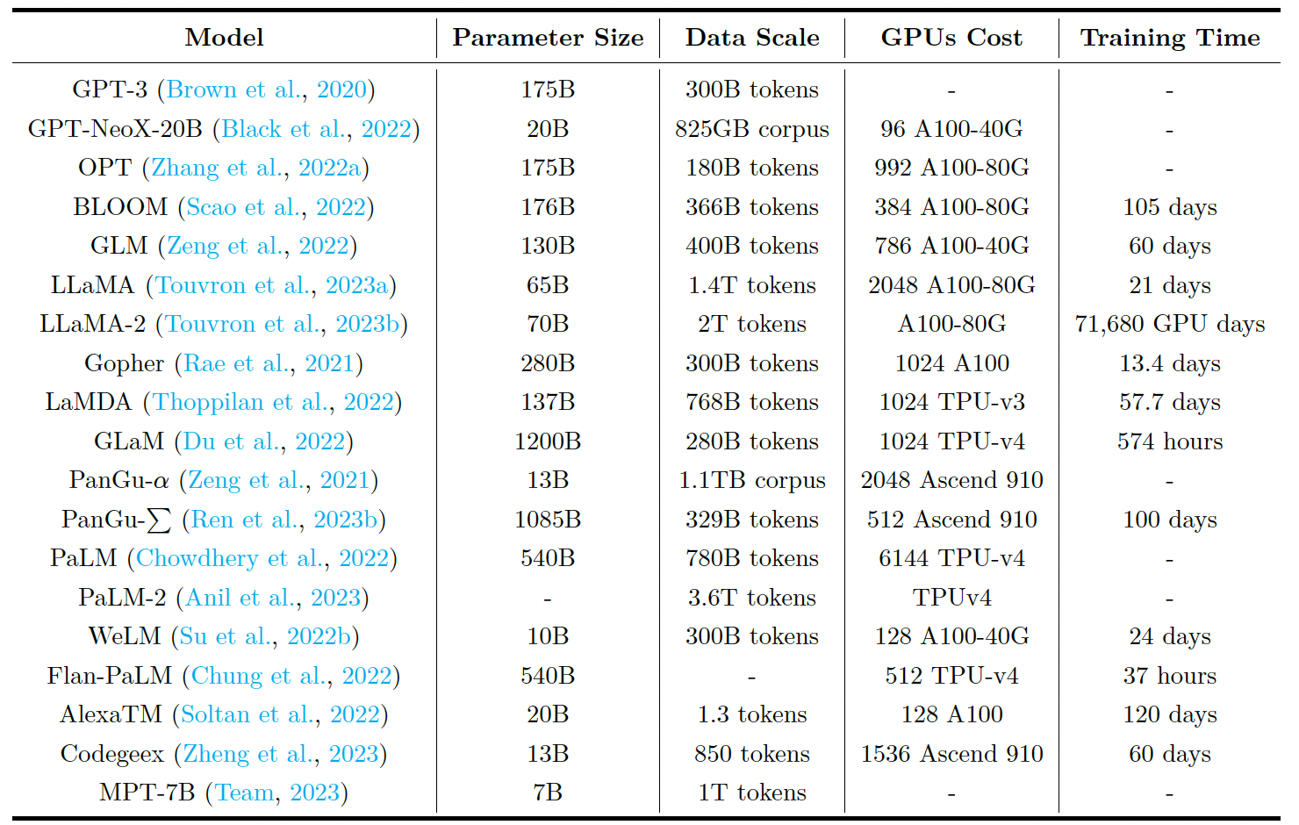
Some LLMs and their training requirements
Source: “Efficient Large Language Models: A Survey” by Wan et al. 2024

Slide 3
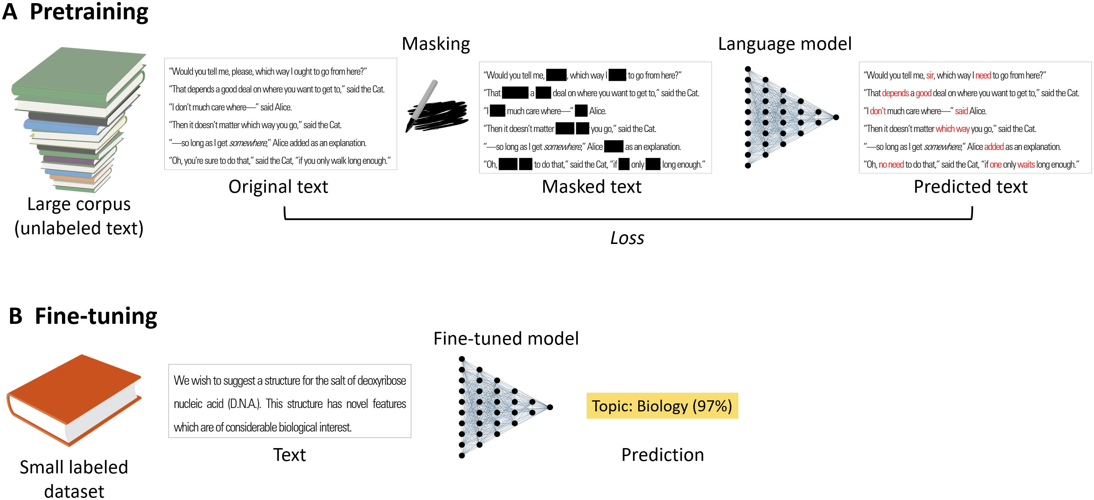
Source: D.Ofer et al., “The language of proteins: NLP, machine learning & protein sequences”
Learning in LLMs
Source:A, Radford et al., “Improving Language Understanding by Generative Pre-training”

Slide 4
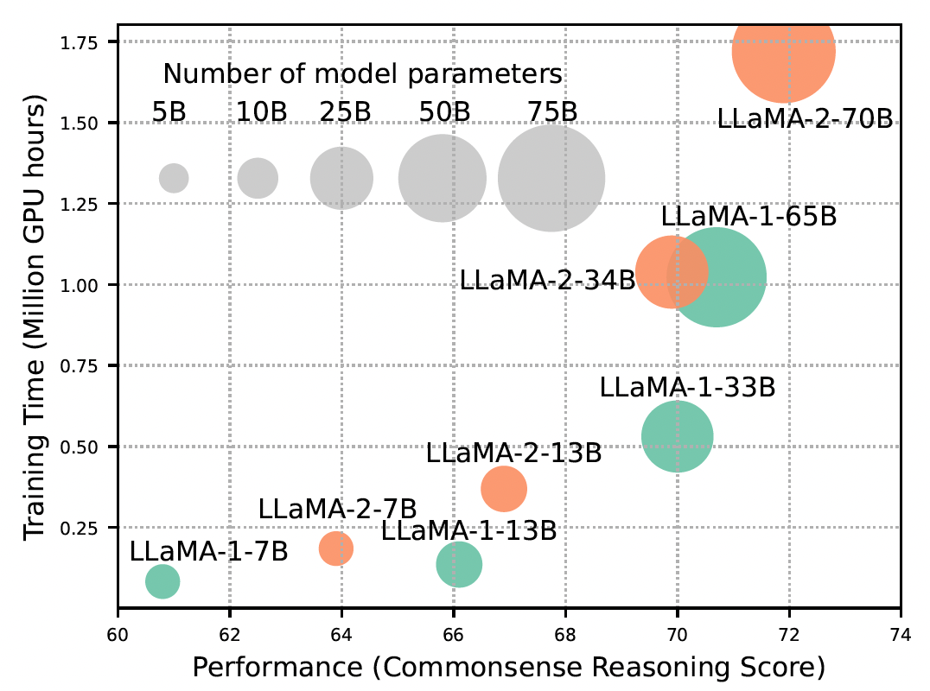
Exponential scaling of training time with performance
Source: “LLaMA: Open and efficient foundation language models” by Touvron et al. 2023
Notes:
Illustration of model performance and model training time in GPU hours of LLaMA models at different scales. The reported performance is the average score of several commonsense reasoning benchmarks. The training time is based on Nvidia A100 80GB GPU. The size of each circle corresponds to the number of model parameters.

Slide 5
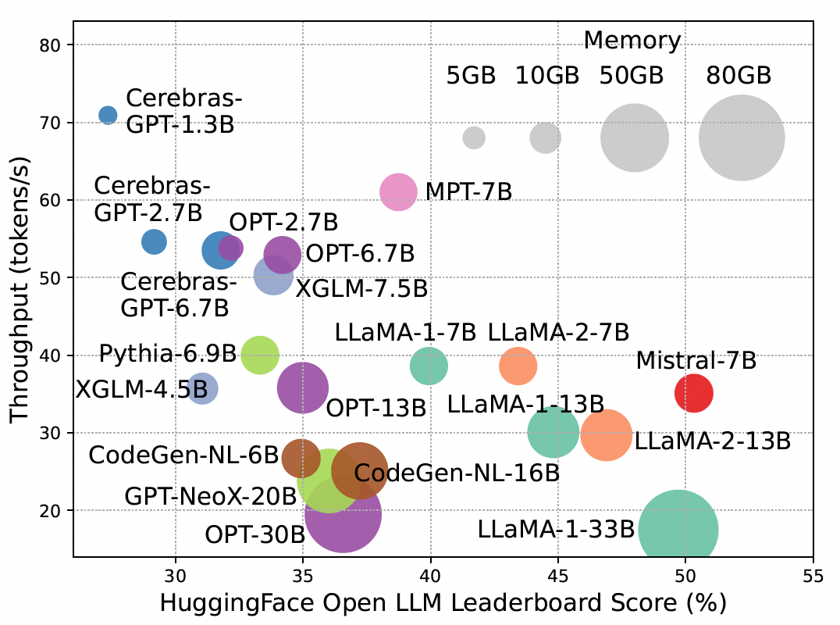
Inference is also computationally heavy
Note Mistral-7B:
Grouped-query attention
Sliding window attention
Source: Hugging Face – LLM perf leaderboard - 2023
Notes:
Performance score vs. inference throughput for various LLMs. The throughputs are measured on Nvidia A100 80GB GPU with 16-bit floating point quantization. The size of each circle corresponds to the memory footprint (in Gigabytes) of each model when running with batch size of 1, prompt size of 256 and generating 1000 tokens.

Slide 6
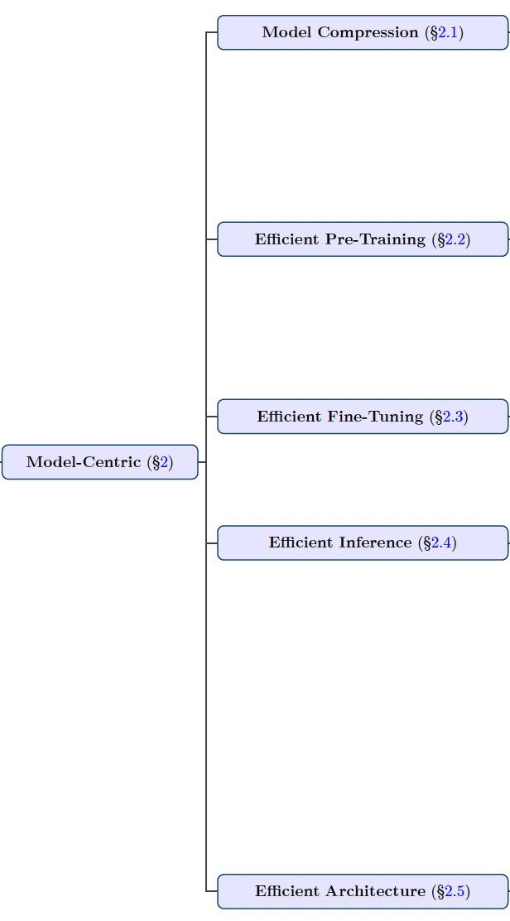
Overview & high-level taxonomy
This presentation will focus on Model-Centric methods for efficient generative AI
But note that there are also other approaches for efficient generative AI
Data-Centric methods (e.g., data selection)
Frameworks (e.g., Megatron, DeepSpeed)
Source: “Efficient Large Language Models: A Survey” by Wan et al. 2024

Slide 7
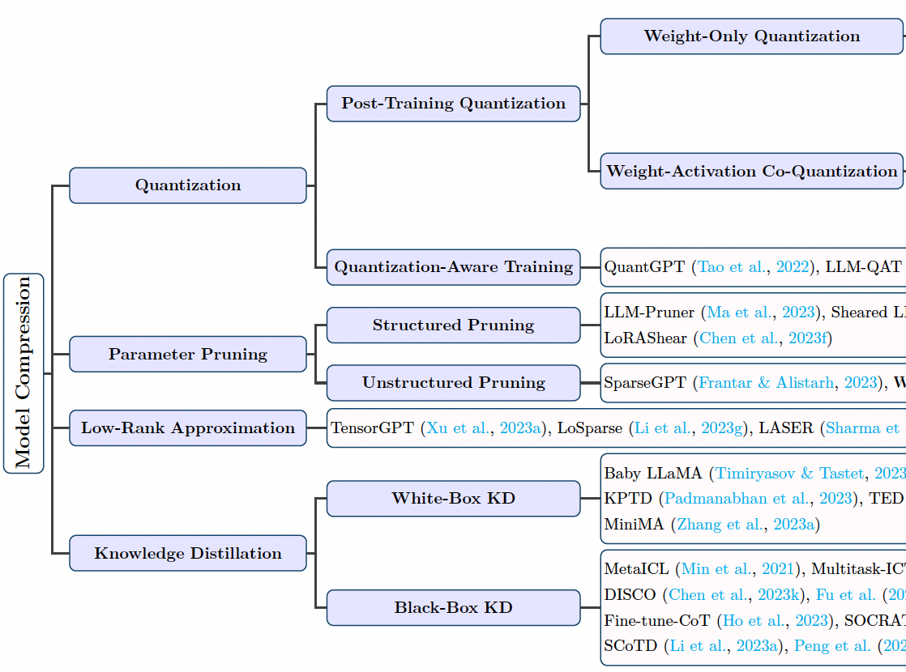

Model compression methods
Source: “Efficient Large Language Models: A Survey” by Wan et al. 2024

Slide 8
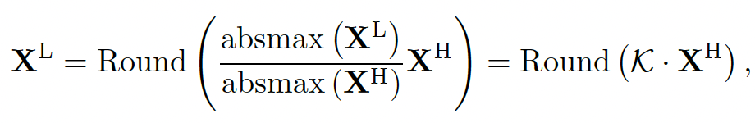
Quantization methods
Example: from 32-bit floating point to 8-bit integer representations of weights and/or activations
Post-Training Quantization (PTQ)
Weight-Only quantization (e.g., LLM.int8() to reduce memory usage during inference)
Weight-Activation co-quantization: much harder because activations often include outliers
It only requires a small validation dataset for final tuning of weights
Quantization-Aware Training (QAT)
Goal: learn quantization-friendly representations
But requires the complete training dataset
Source: “Efficient Large Language Models: A Survey” by Wan et al. 2024

Slide 9
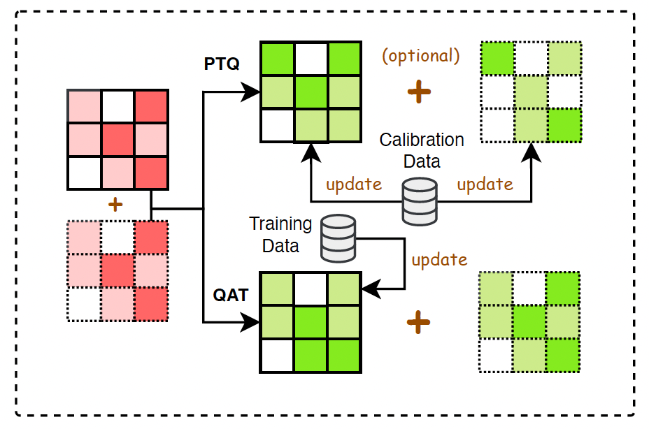
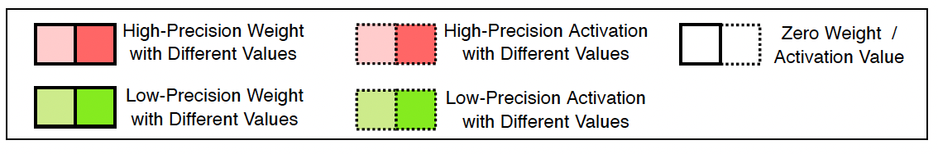
Quantization methods
Examples:
GPTQ (3-4 bits/weight)
ZeroQuant (PTQ weights & activations)
QuantGPT (QAT)
Source: “Efficient Large Language Models: A Survey” by Wan et al. 2024

Slide 10
Neural network pruning
The concept has been around since the late 80s
But mostly performed after training – only improves inference

Slide 11
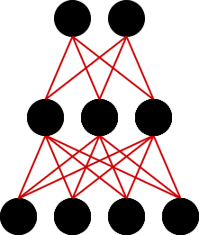
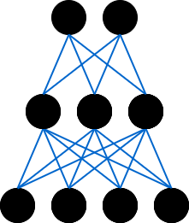
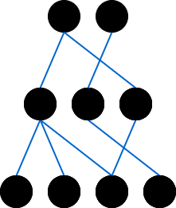
Neural network pruning – after training
Train the given dense network
Remove insignificant components
Re-train from scratch
Optionally : repeat steps 2 and 3 iteratively
Weight magnitude, gradients etc.
Edges, neurons, filter channel etc.
Train
Prune
Fine-tune

Slide 12
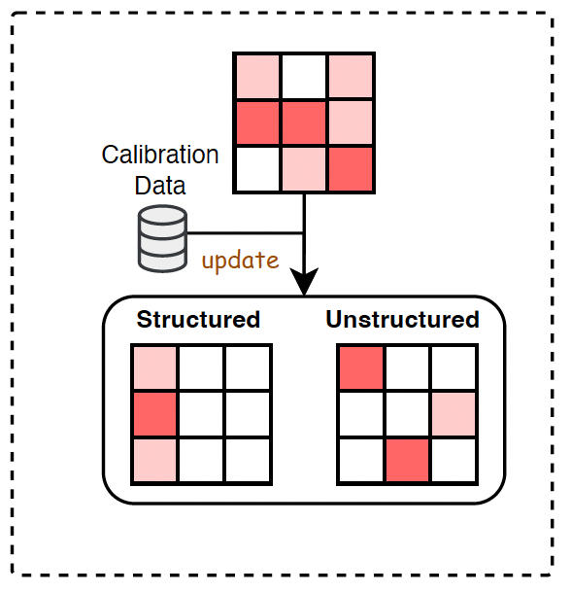
Structured vs Unstructured pruning
Structured: remove entire layers, filters in conv-nets, attention heads, rows/columns/subblocks of LLM weight matrices
Sheared LLaMMA: Prune LLaMMA-2-7B down to 1.3B parameters
Unstructured: removes individual weights – more flexible. But it may not be supported by underlying hardware.
SparseGPT: completely avoids retraining – prunes 60% of the OPT-135B model parameters with minimal loss of performance
Source: “Efficient Large Language Models: A Survey” by Wan et al. 2024

Slide 13
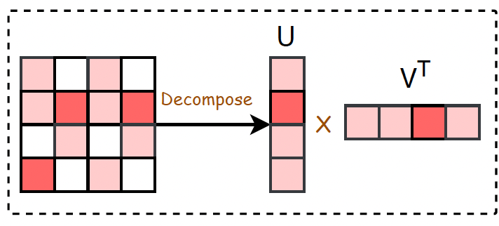

Low-Rank Approximations
Reduce number of parameters
Example: TensorGPT compresses embedding layers of LLMs using Tensor-Train Decomposition
Some loss in performance should be expected depending on size of dimension r
Source: “Efficient Large Language Models: A Survey” by Wan et al. 2024

Slide 14
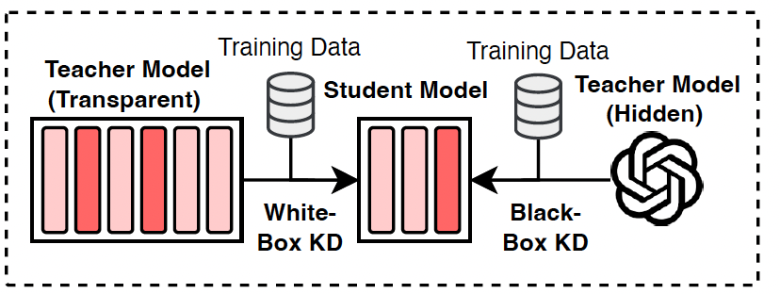
Knowledge Distillation (white-box vs black-box)
Student model is much smaller than teacher model
Student model is trained to emulate teacher model
Student model is much more efficient during inference
E.g. (white box): BabyLLaMA (58M parameters)
E.g. (black box): DISCO prompts LLM to generate counterfactual data, distilled on student models
Source: “Efficient Large Language Models: A Survey” by Wan et al. 2024

Slide 15
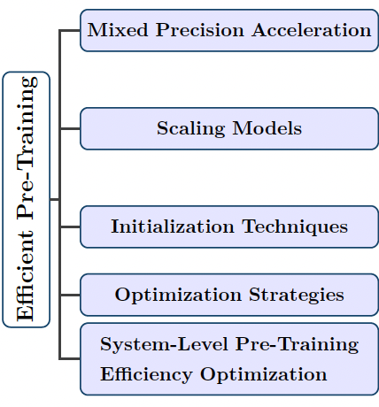
Methods for efficient pre-training
Source: “Efficient Large Language Models: A Survey” by Wan et al. 2024

Slide 16
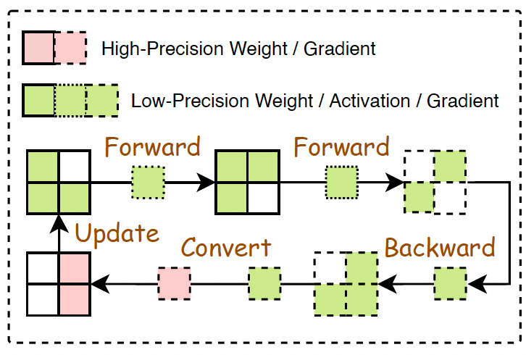
Mixed-Precision Acceleration
Use LP model for forward and backward propagation – but convert LP gradients to HP gradients before updating HP weights
Example: AMP (automatic mixed precision) keeps copy of FP32 weights for updates – but weights, activations, gradients are stored in FP16 for arithmetic operations
Source: “Efficient Large Language Models: A Survey” by Wan et al. 2024
Notes:
Mixed precision acceleration enhances pre-training efficiency by using the low-precision model for forward and backward propagation and converting the calculated low-precision
gradients to high-precision ones for updating the original high-precision weights. For example, Micikevicius et al. (2017) propose Automatic Mixed Precision (AMP) to keep a master copy of weights in full-precision FP32 for updates, whereas weights, activations, and gradients are stored in FP16 for arithmetic operations.

Slide 17
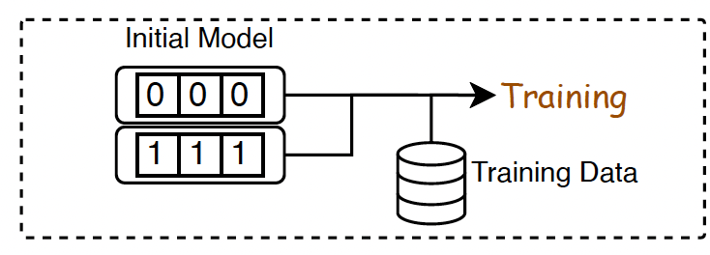
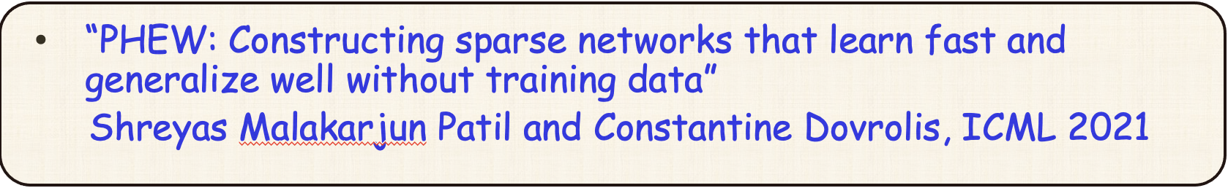
Initialization methods
Initial weights can strongly affect learning speed and generalizability

Slide 18
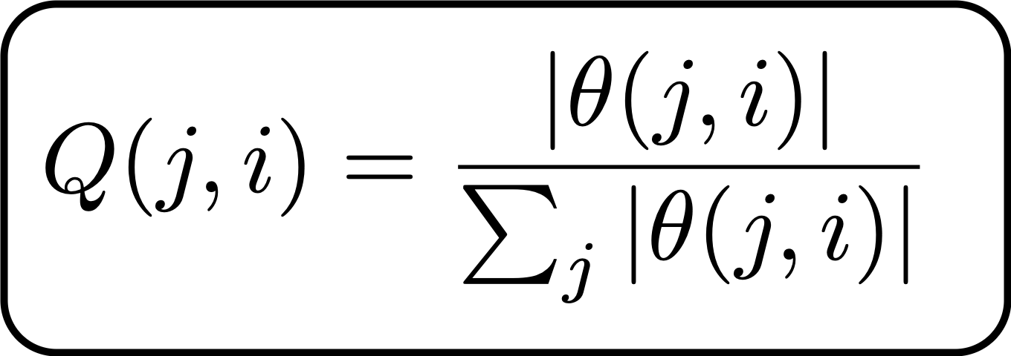
PHEW: Paths with High Edge-Weights
Given a dense, randomly initialized neural network and
a target number of weights / parameters ( m = 12 )
11
/ 12
2
0
12
10
4
9
Number of weights :
6
8
Increasing weight magnitude
Starting unit selected through round robin from both inputs and outputs

Slide 19
What we get from PHEW
Sparse initial network
Faster convergence/
efficient pre-training compared to dense network
Better generalization than other sparse networks of the same density

Slide 20
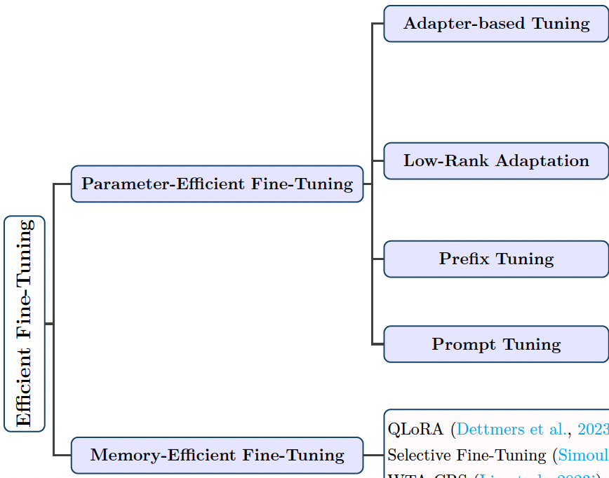
Methods for efficient fine-tuning
Source: “Efficient Large Language Models: A Survey” by Wan et al. 2024

Slide 21
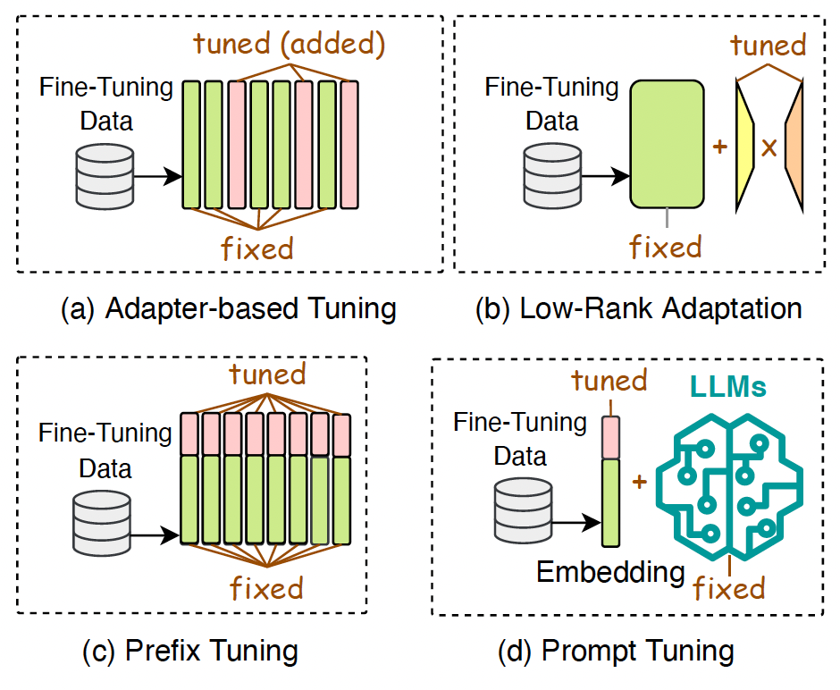

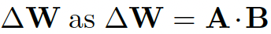
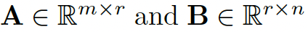
Methods for parameter-efficient fine-tuning
Bottleneck modules added in fixed architecture for specific tasks
E.g. LLM-Adapters
E.g. LoraHub
Add short trainable vectors for each task in each layer
E.g., LLaMA-Adapter
The LLM model remains fixed – only trainable prompt tokens are added/encoded at input layer
E.g., P-Tuning
Source: “Efficient Large Language Models: A Survey” by Wan et al. 2024

Slide 22
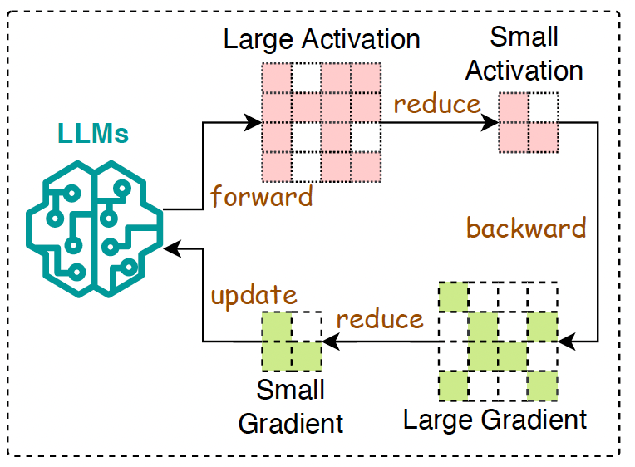
Methods for memory-efficient fine-tuning
Quantize model into low-precision – then fine-tune quantized model with LoRA
E.g. QLoRA
Source: “Efficient Large Language Models: A Survey” by Wan et al. 2024

Slide 23
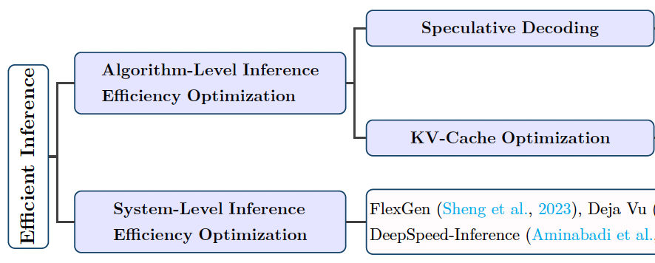
Methods for efficient inference
Source: “Efficient Large Language Models: A Survey” by Wan et al. 2024

Slide 24
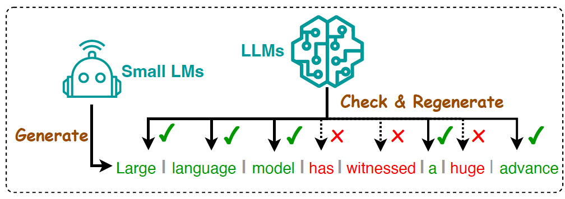
Speculative Decoding
Smaller (faster) models generate speculative tokens for the target model.
Those can be rejected or revisited by the target model
E.g. BiLD, SpecInfer
Source: “Efficient Large Language Models: A Survey” by Wan et al. 2024

Slide 25
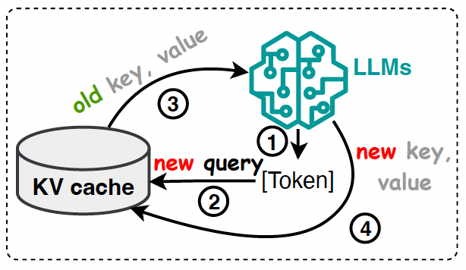
KV-Cache Optimization
Without KV-cache, attention computation requires quadratic compute with sequence length.
Masking of subsequent tokens (not yet generated) creates redundant computations in self-attention.
Keys and Values for previous tokens can be reused in attention computations for subsequent tokens – and so they are cached.
- Linear scaling with sequence length
Many possible optimizations for KV-Cache:
- different eviction strategies
- E.g. Dynamic Context Pruning
Source: “Efficient Large Language Models: A Survey” by Wan et al. 2024

Slide 26
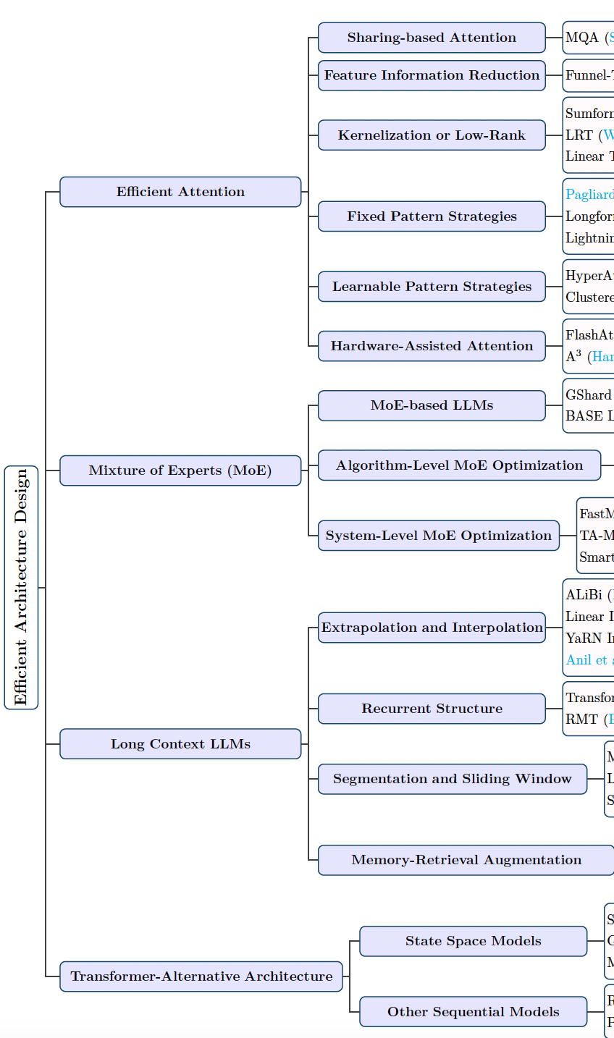
Efficient architectures
Source: “Efficient Large Language Models: A Survey” by Wan et al. 2024

Slide 27
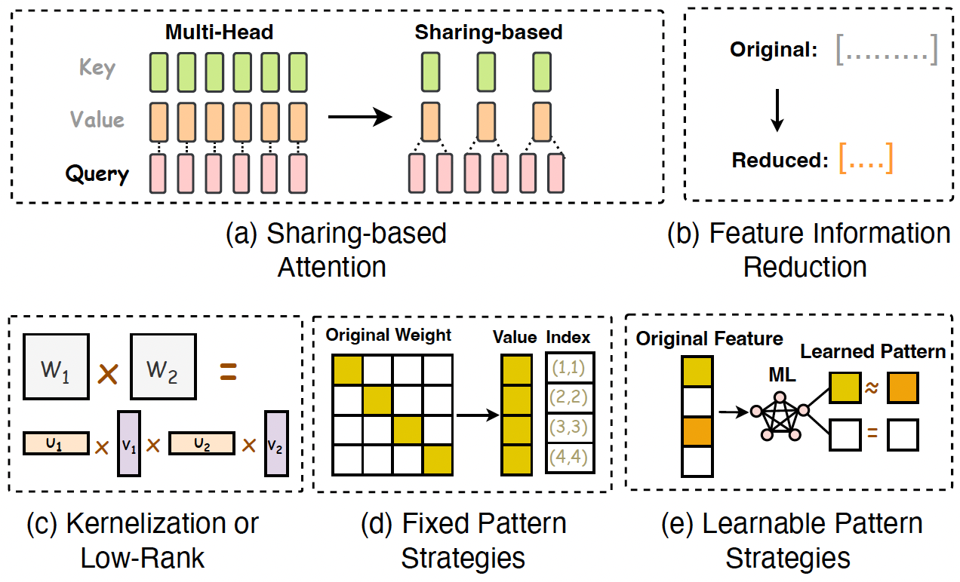
More advanced attention architectures
Share keys, values across attention heads.
E.g., MQA, GQA
Reduce dimensionality of attention keys, values. Approximate attention calculations.
Source: “Efficient Large Language Models: A Survey” by Wan et al. 2024

Slide 28
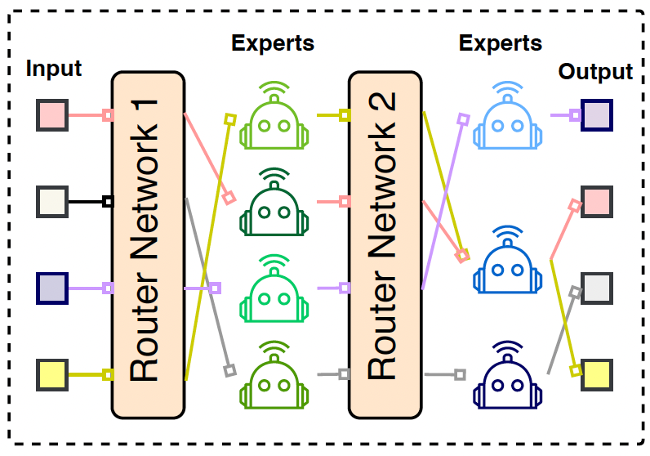
Mixture-of-Experts models
Segment given task into subtasks. Each subtask allocated to an “expert”.
E.g., Switch Transformer:
1 trillion parameters, 2048 experts
MoE models use learnable routing algorithms.
Router performs token-to-expert assignment.
Source: “Efficient Large Language Models: A Survey” by Wan et al. 2024

Slide 29
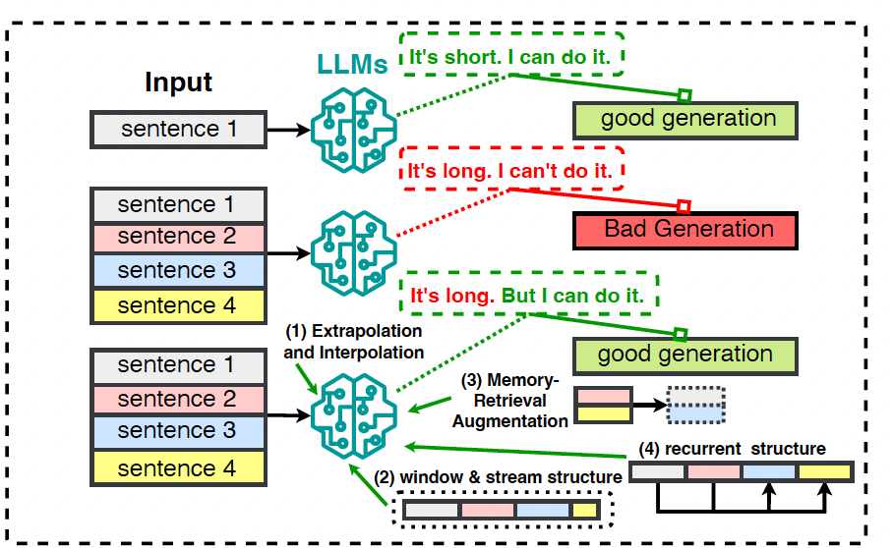
Long-context LLMs
What if given (or generated) sequence is much longer than anything seen during pre-training?
Extrapolation/Interpolation: replace positional encoding – e.g., with diminishing penalty based on distance between pertinent key and value
Sliding window/segmentation: compute attention over a sliding window -- instead of the entire context length
Source: “Efficient Large Language Models: A Survey” by Wan et al. 2024

Slide 30
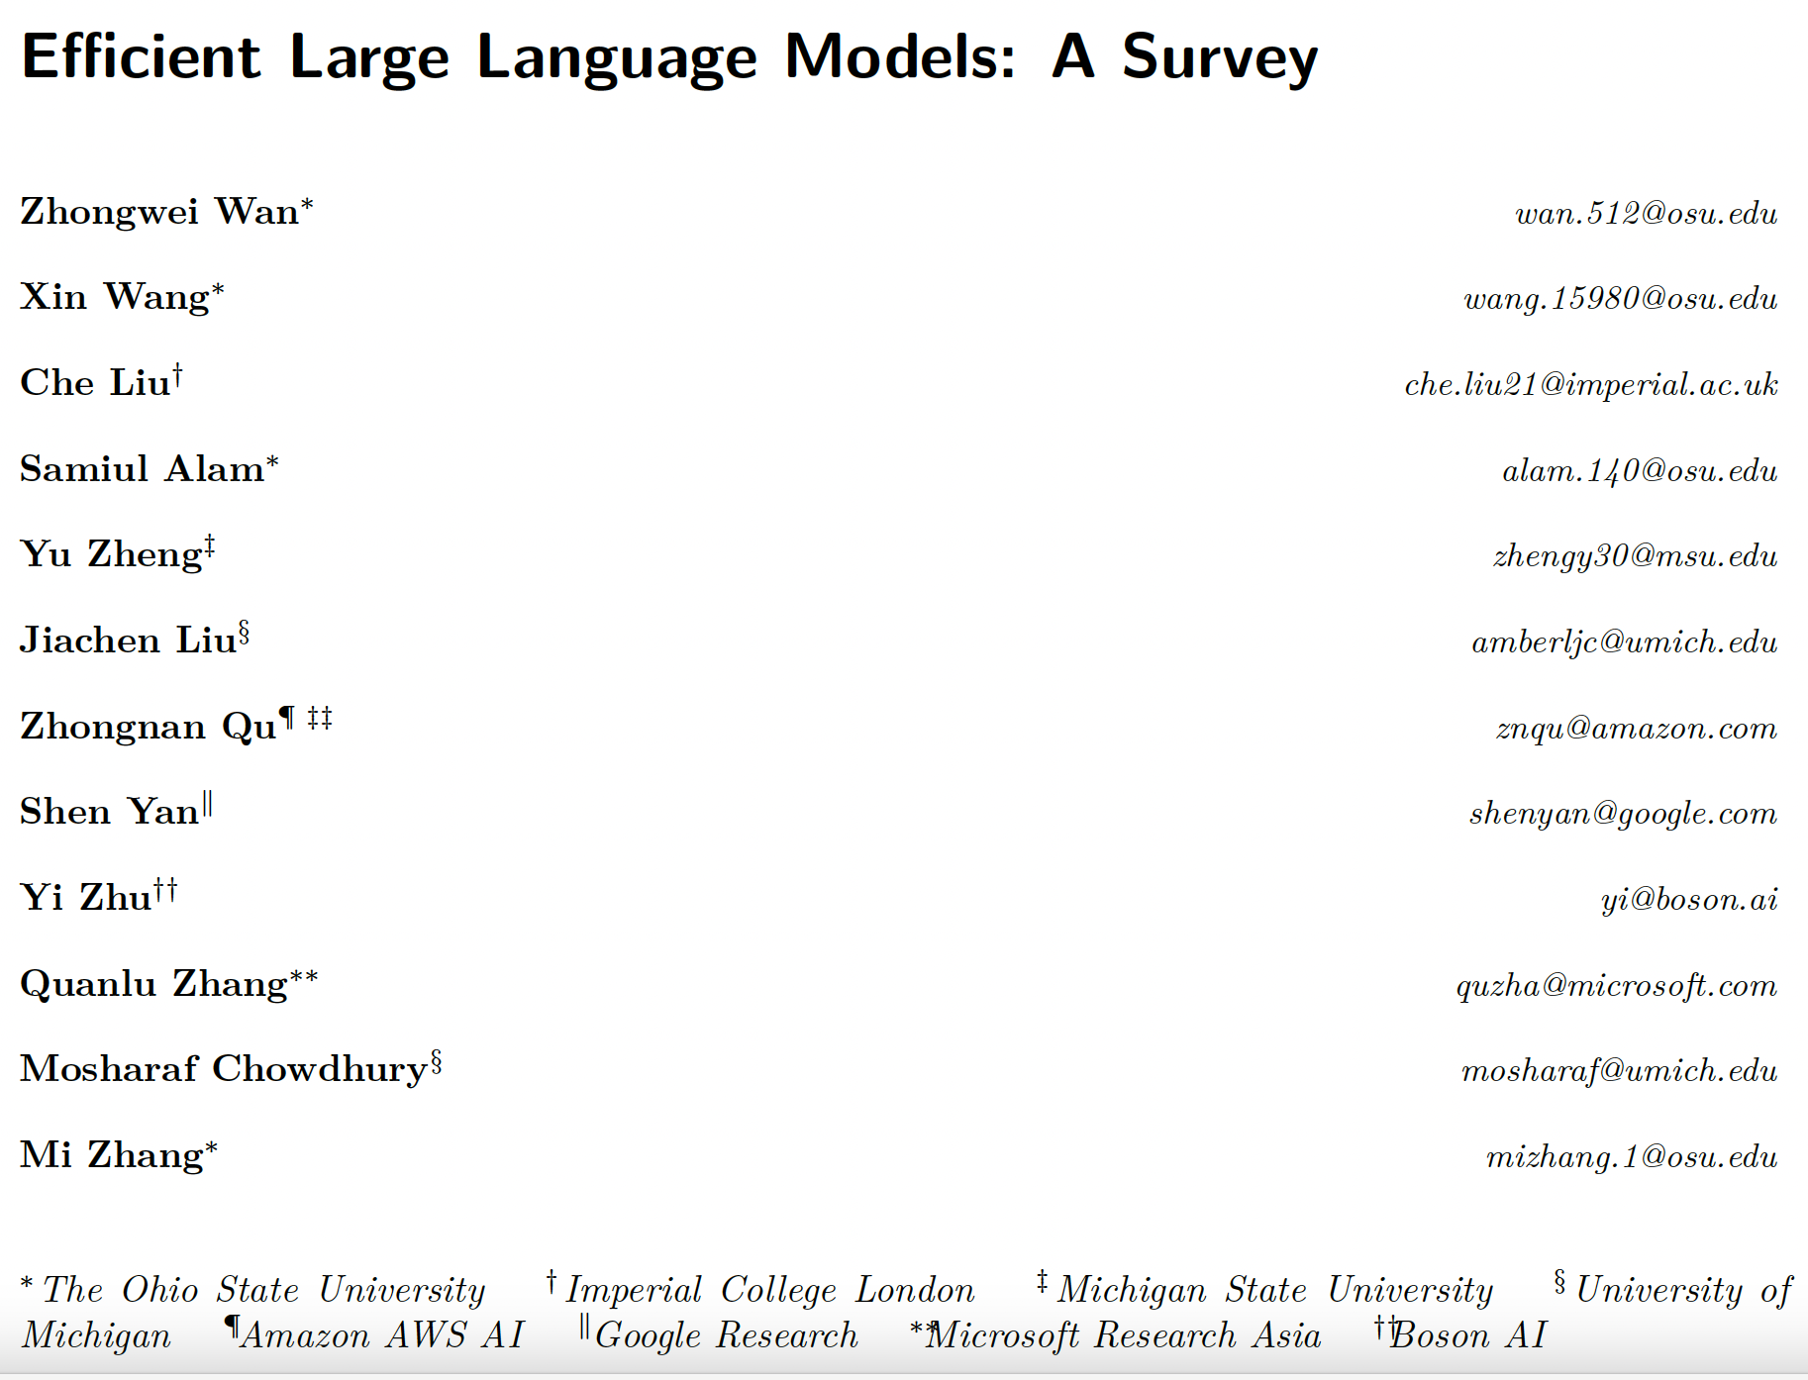
An excellent survey (Arxiv: 2312.03863)

Slide 31



Thanks for your attention Please email me if you have any questions or feedback c.dovrolis@cyi.ac.cy
Supported by the EuroCC-2 project

